Slide 1


MECE 4510 EVOLUTIONARY COMPUTATION AND DESIGN AUTOMATION
Assignment 3 Phase C Presentation
Yifan Gui
UNI: yg2751
Instructor:
Dr. Hod Lipson
Grace Hour Used: 0
Grace Hour Gained: 0
Grace Hour Remaining: 92
Dec 8, 2020
Presentation link: https://youtu.be/Da6KTVdmTec
TRANSCENDING DISCIPLINES, TRANSFORMING LIVES

Slide 2

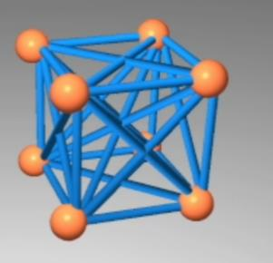
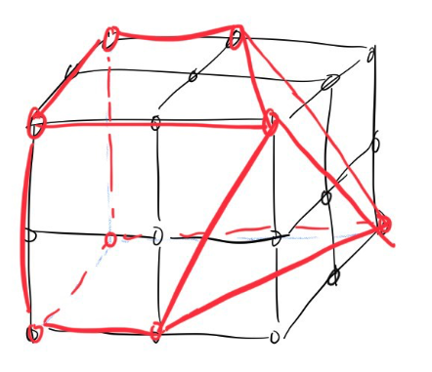
Design ideas
Reference: https://www.creativemachineslab.com/soft-robot-evolution.html
Yifan Gui (yg2751)
<number> | MECS 4510 Phase C Presentation

Slide 3
Methods
Genetic programming:
Gene: data that describes coordinates of masses, spring locomotion parameters
Chromosome: a solution that contain genes.
Initial population: 1st batch of solutions that generated randomly
Fitness and selection: here we select top 50% best solutions as parents.
Operations: mutation and crossover
Offspring: solutions that contains part of genes from parents.
Parent 1
Parent 2
Crossover and Mutation
children
Yifan Gui (yg2751)
<number> | MECS 4510 Phase C Presentation

Slide 4
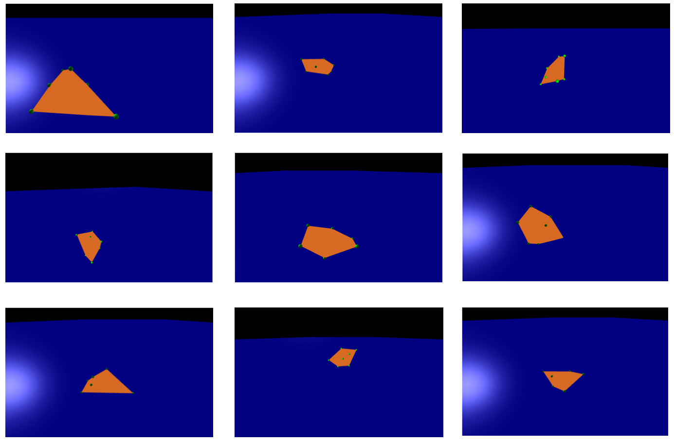
Robot zoo
Yifan Gui (yg2751)
<number> | MECS 4510 Phase C Presentation

Slide 5

Fastest robot
Yifan Gui (yg2751)
<number> | MECS 4510 Phase C Presentation

Slide 6
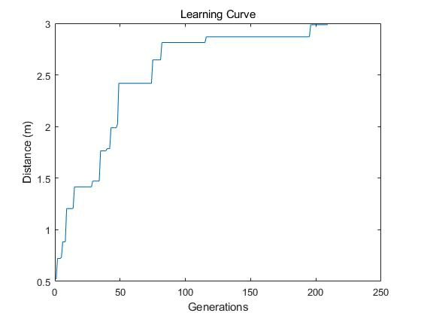
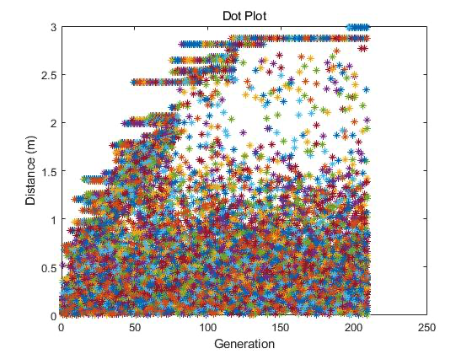
Performance Plots
<number> | MECS 4510 Phase C Presentation

Slide 7
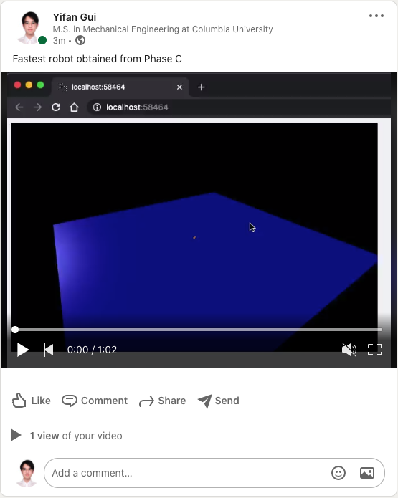
Thanks for watching!
https://www.linkedin.com/feed/update/urn:li:ugcPost:6742353826889773057/
<number> | MECS 4510 Phase C Presentation

